Slide 1

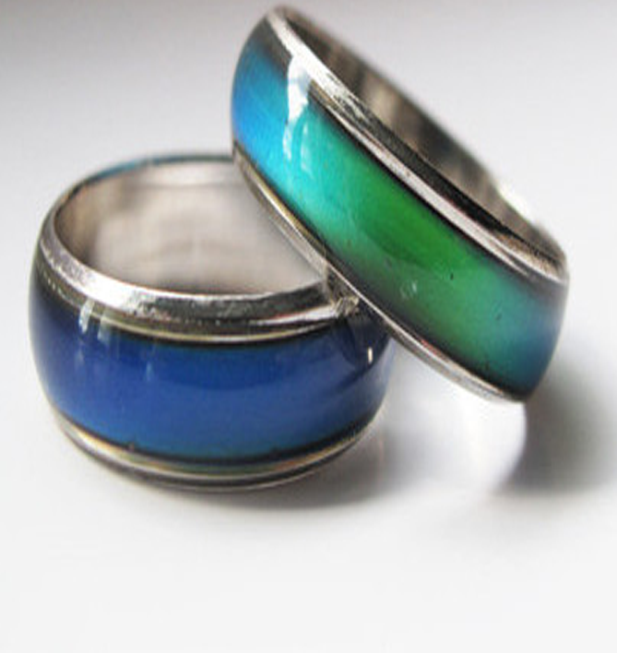
WWCode IoT Hackathon 2018 Sustainable Futures Air Quality Smart Ring
Team #4
March 2018

Slide 2
Agenda
The Problem
The Solution
How it Works – Hardware
How it Works - Interface
Vision
Team

Slide 3
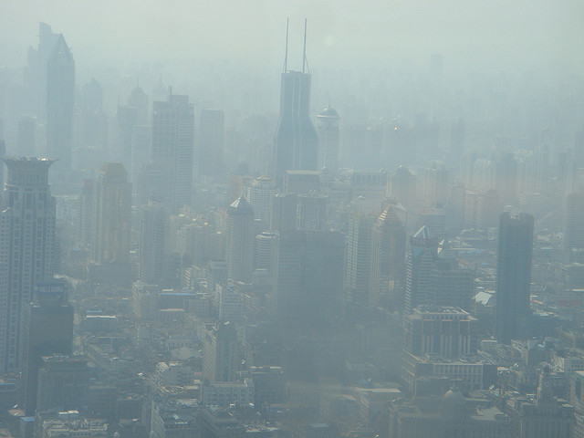

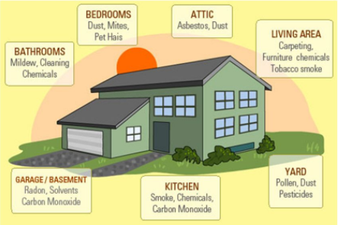

The Problem
Notes:
The new study, published in the journal The Lancet and written by more than 40 international health and environmental experts, uses data from the the Global Burden of Disease, an international study that examines trends across populations and estimates mortality from major diseases and their causes.
Air pollution was linked to 6.5 million deaths in 2015, water pollution was linked to 1.8 million deaths and workplace pollution was linked to nearly one million deaths.

Slide 4
The Solution

Slide 5
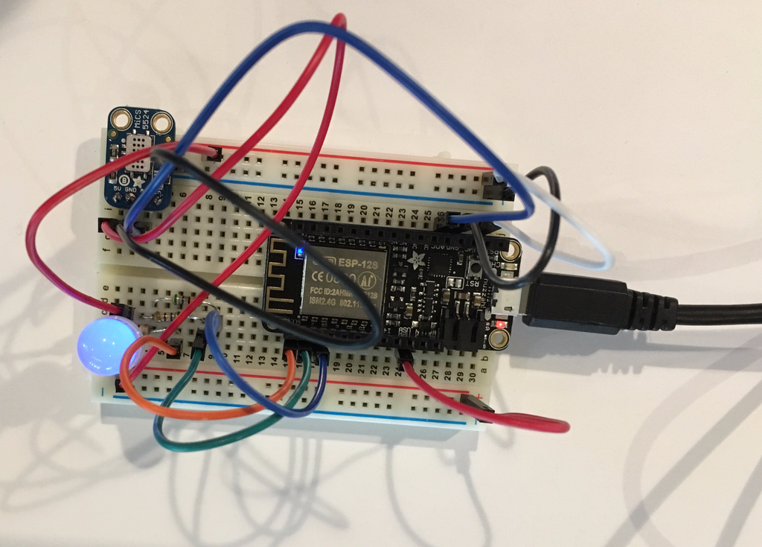
How it Works - Hardware
Sensor:Adafruit MiCS5524 CO / Alcohol / VOC Gas Sensor Breakout
Microcontroller:Feather HUZZAH w/ ESP8226 Wifi
Indicator Color Key:
Good — Green
Moderate — Yellow
USG — Orange
Unhealthy — Red
Very Unhealthy — Purple
Hazardous — Blue
Indicator:Diffused RGB (tri-color) LED

Slide 6
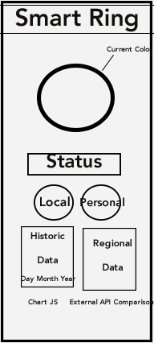
How it Works – The Interface

Slide 7
Vision
Phase | Proof Of Concept | Version 1 | Version 2
Gas Sensor
Particle Sensor
Temperature Sensor
Wrist Band
Necklace
Ring
Geo Tracking
ADA Accessible
Interface with Location AQI
Social Responsibility Outreach

Slide 8
Meet Team 4 AQ Smart Ring!
Abbie Jones – Full Stack
Cynthia Smith - Design
Evie Curry – Front End
Lynnae Griffiths – Back End
Sunmi Bausmann – Front End
Traci Esteve – Product Manager

Slide 9
Air Quality Smart Ring: Protect Yourself from your Surroundings

Slide 10
Thank you!
Questions?

